Slide 1
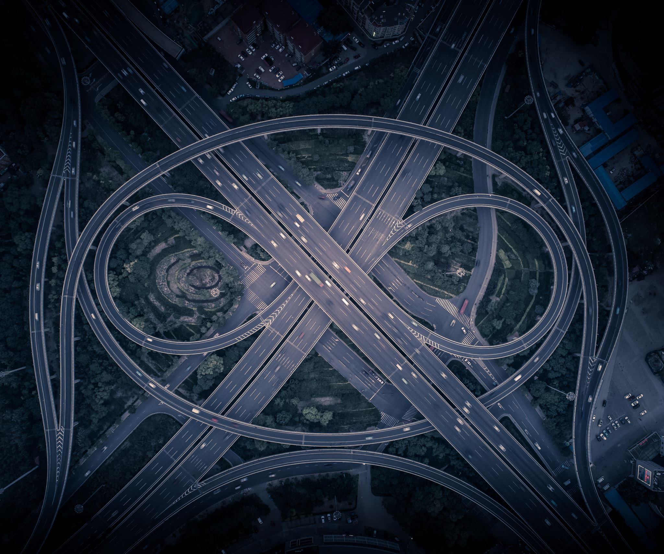
Simulations of Road Traffic
Eliott Menard & Jacob Fairham
Image by Liyao Xie
Notes:
This presentation was automatically generated by PowerPoint Copilot based on content found in this document: https://livemanchesterac-my.sharepoint.com/personal/jacob_fairham_student_manchester_ac_uk/Documents/Rough%20Report.docx AI-generated content may be incorrect.

Slide 2
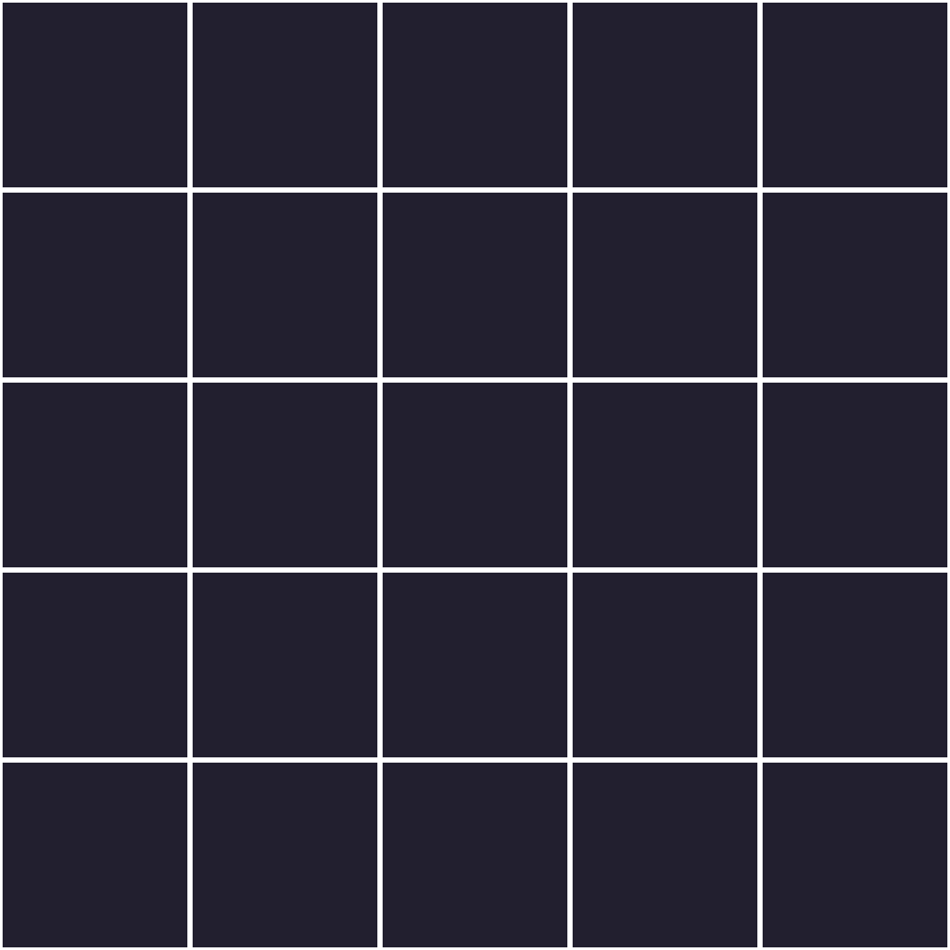
Grid
Scalable grid
Road tiles connect
Press on crossroads for roundabouts
Houses define spawn and death

Slide 3
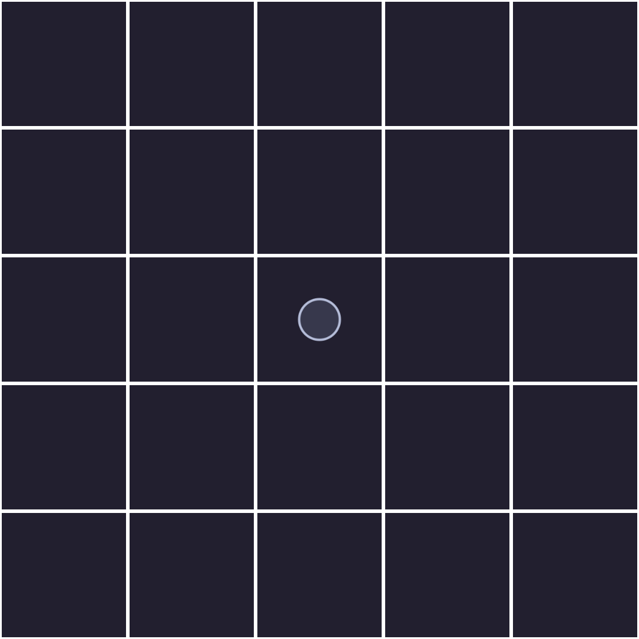
Grid
Scalable grid
Road tiles connect
Press on crossroads for roundabouts
Houses define spawn and death

Slide 4
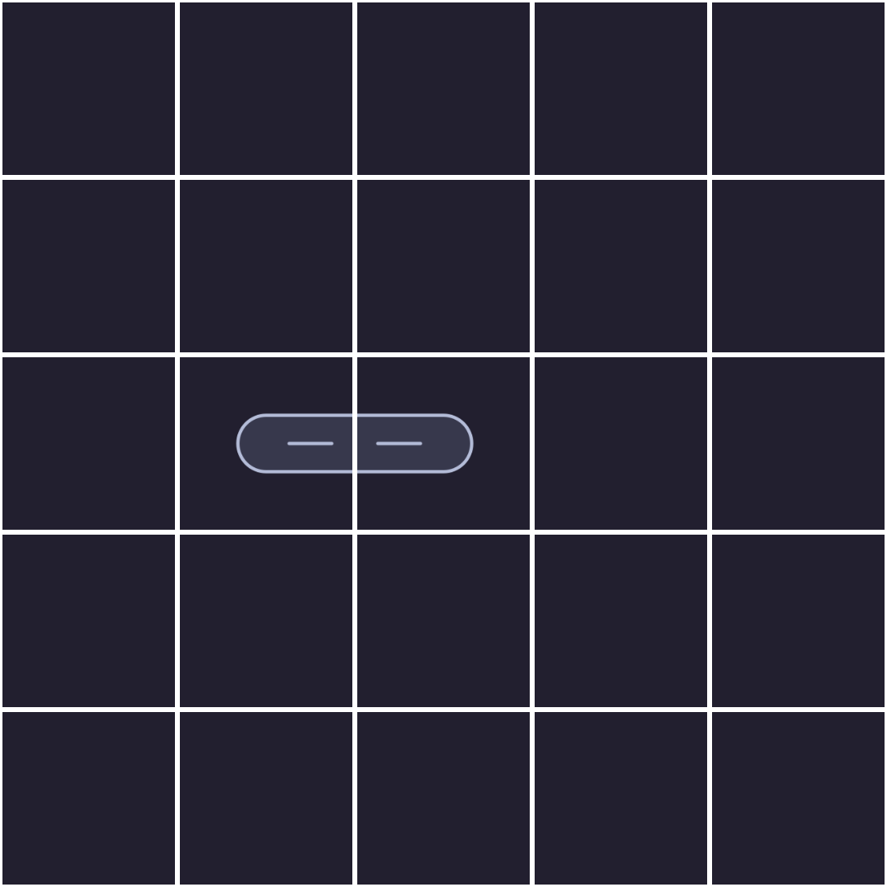
Grid
Scalable grid
Road tiles connect
Press on crossroads for roundabouts
Houses define spawn and death

Slide 5
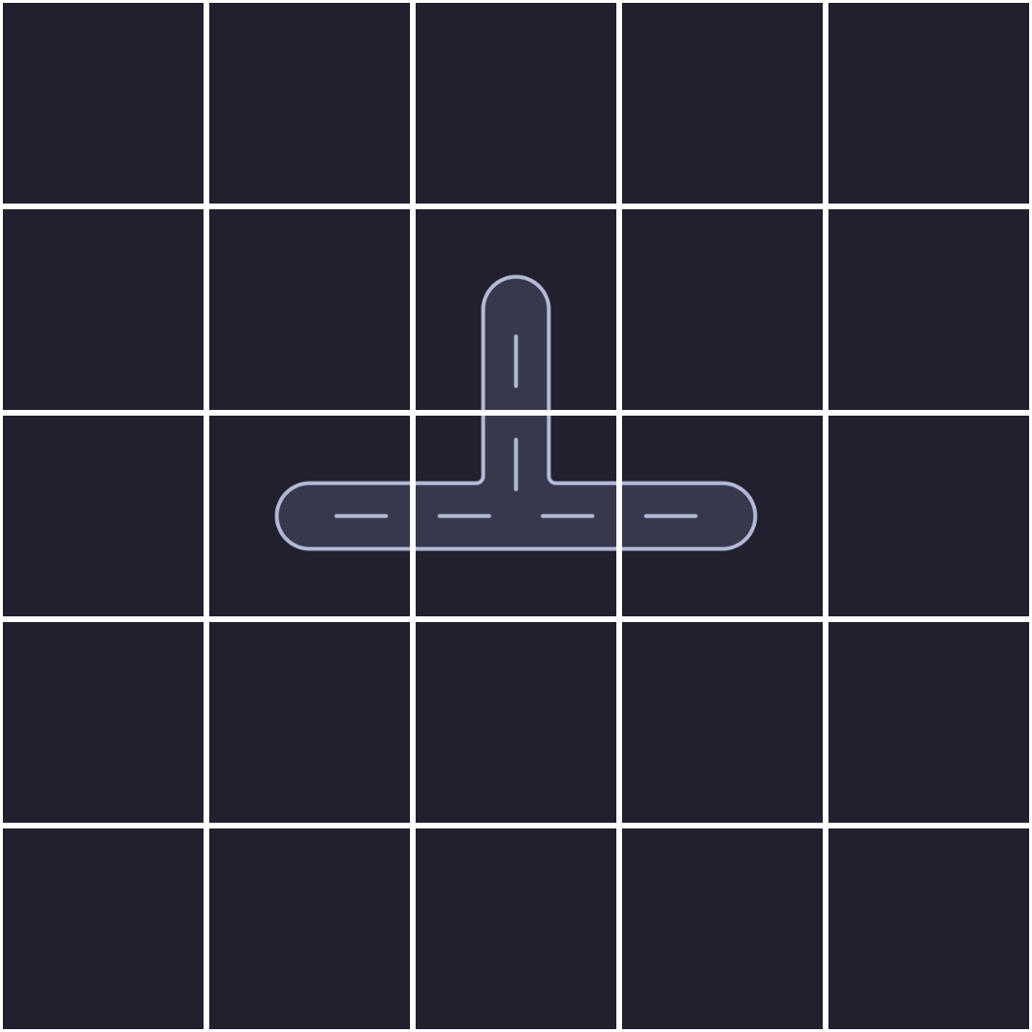
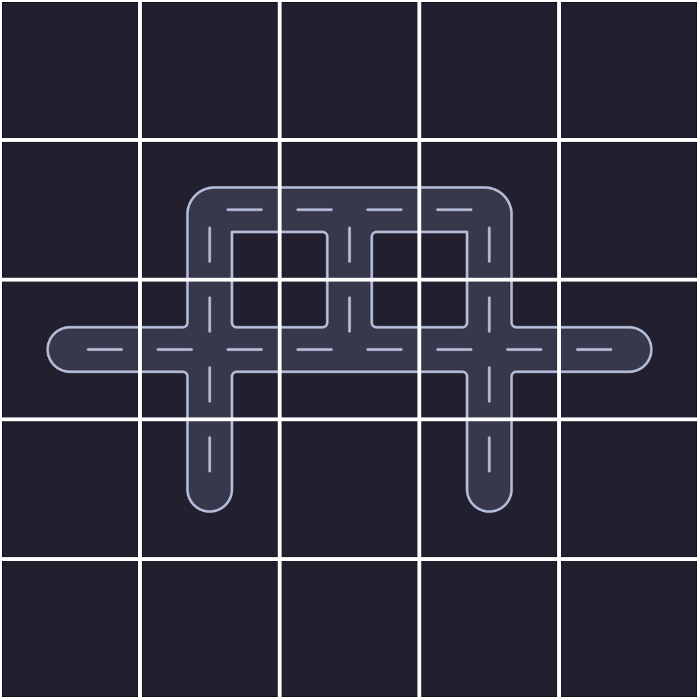
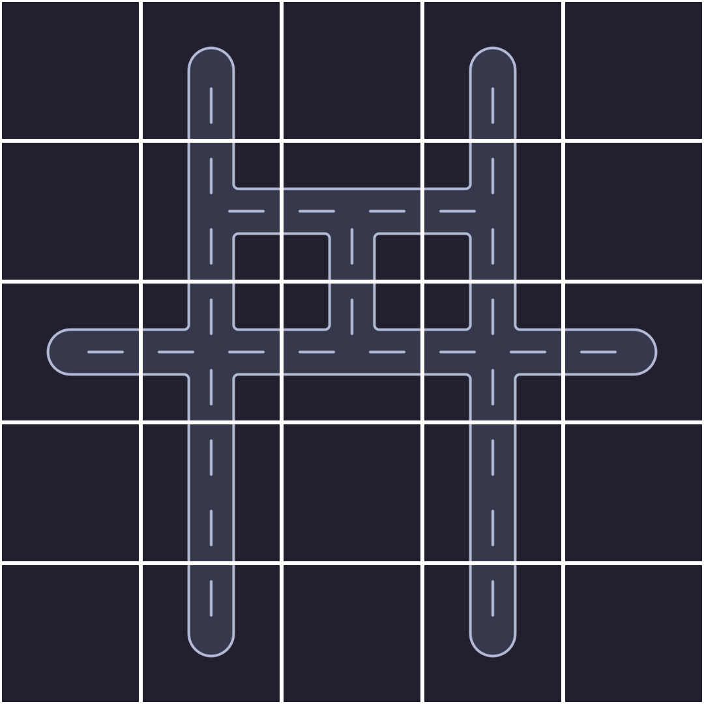
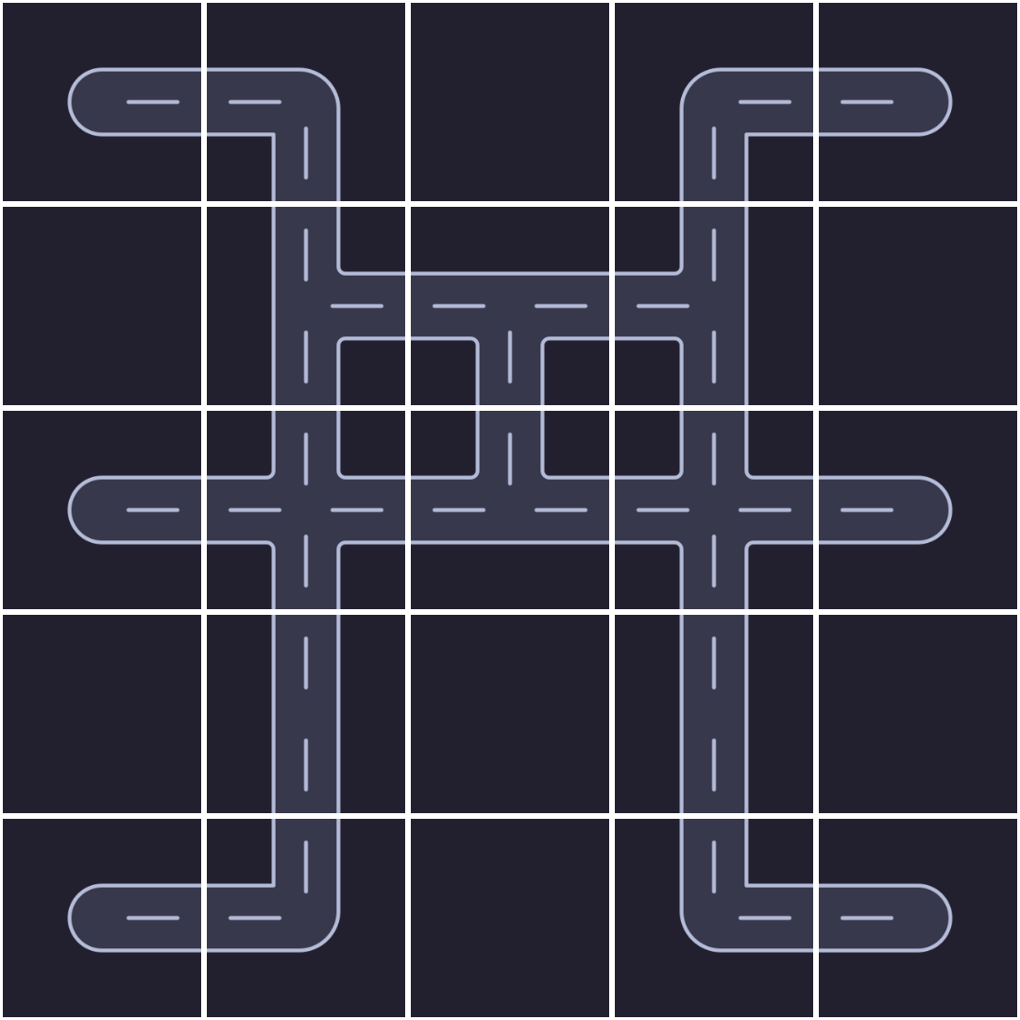
Grid
Scalable grid
Road tiles connect
Press on crossroads for roundabouts
Houses define spawn and death

Slide 6
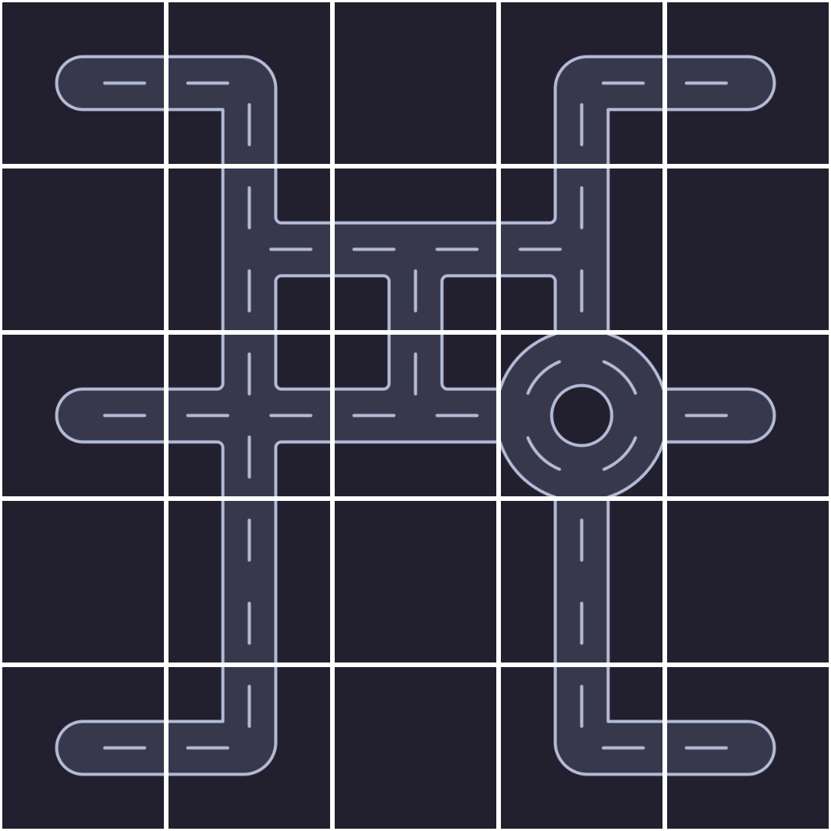
Grid
Scalable grid
Road tiles connect
Press on crossroads for roundabouts
Houses define spawn and death

Slide 7
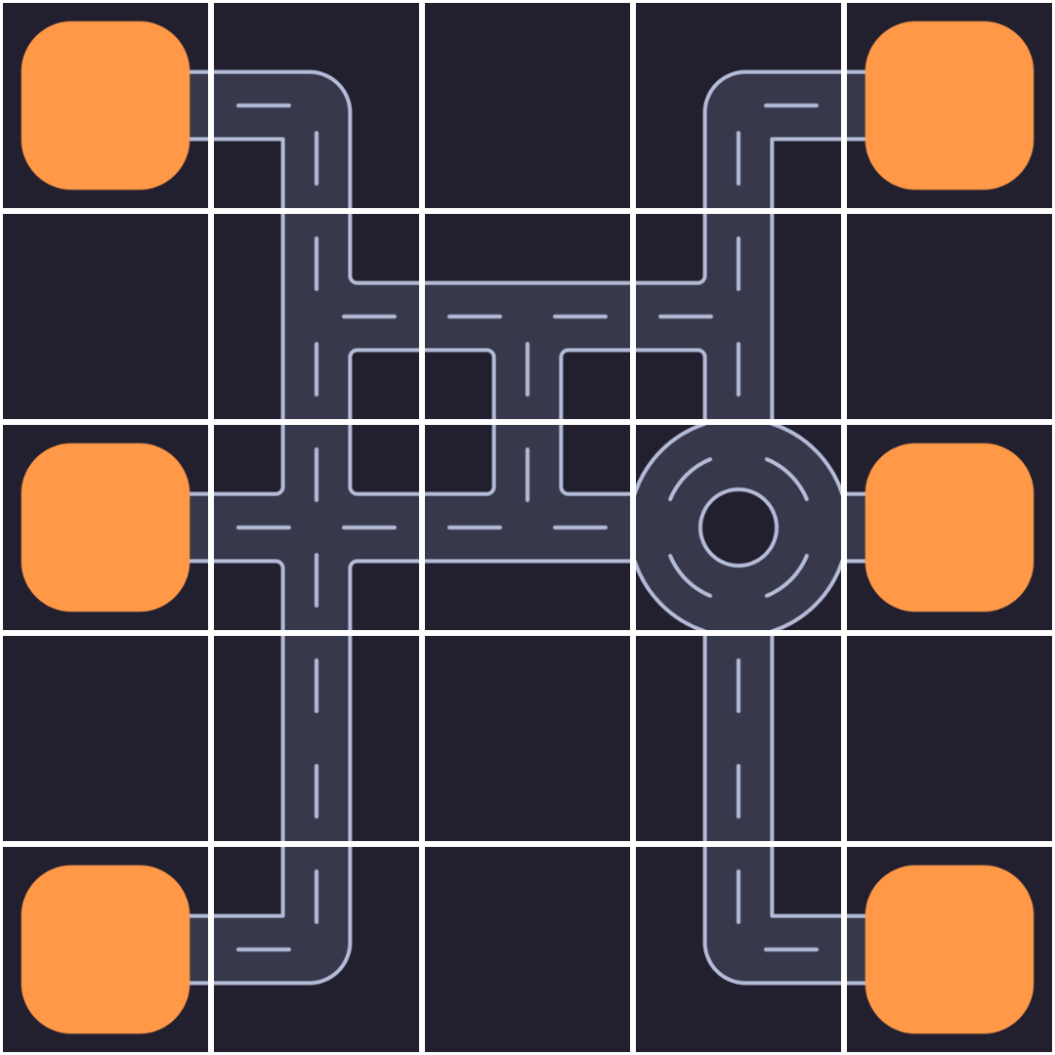
Grid
Scalable grid
Road tiles connect
Press on crossroads for roundabouts
Houses define spawn and death

Slide 8
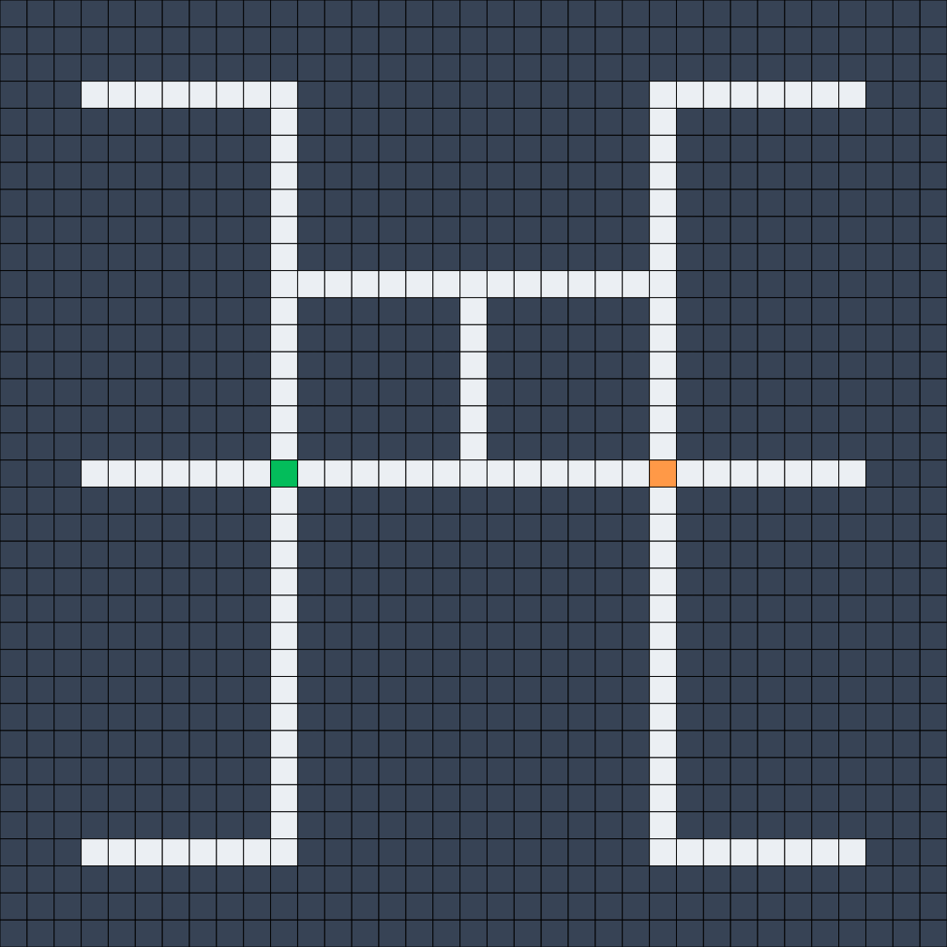
Divided Grid
Subdivided in cells
Green crossroad
Orange roundabout
Clockwise around roundabouts

Slide 9
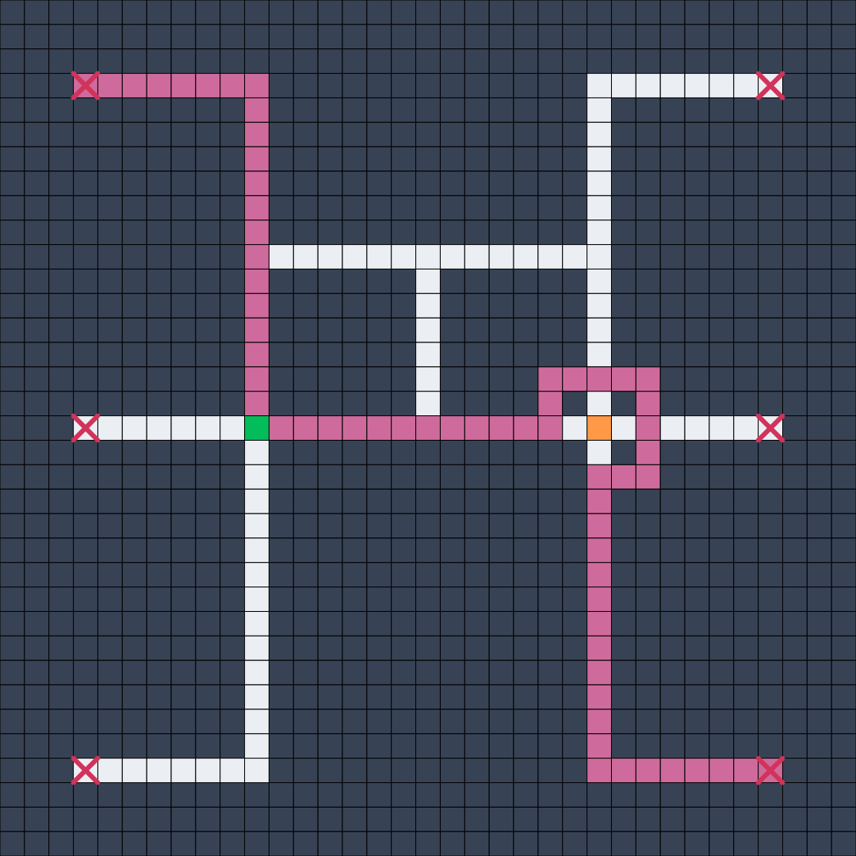
Path Finding
Subdivided in cells
Green crossroad
Orange roundabout
Clockwise around roundabouts

Slide 10
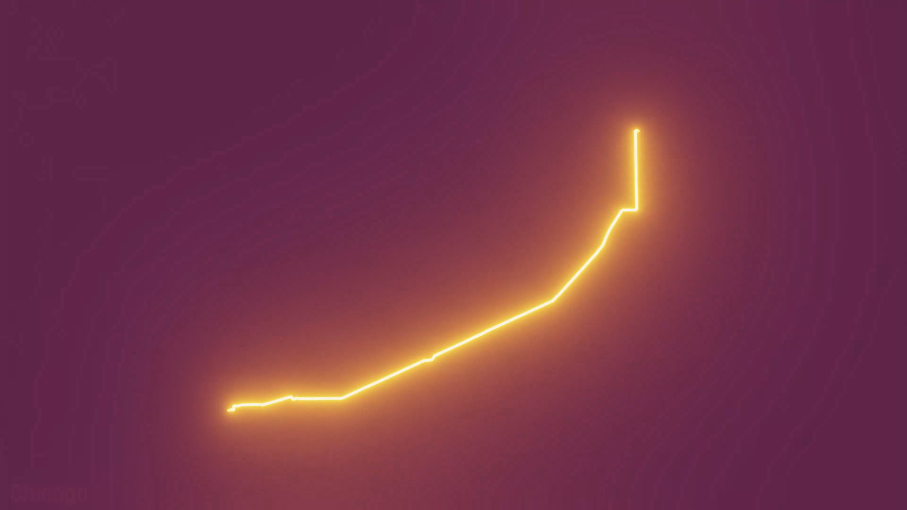
Path Finding
Heuristic function
Source: A* (A-Star) Pathfinding Algorithm Visualizations on a Real Map by ones and zero

Slide 11

Cars
[ ]
↗️ ⏱️
Previous Speed
Path
Rotation
Time alive

Slide 12
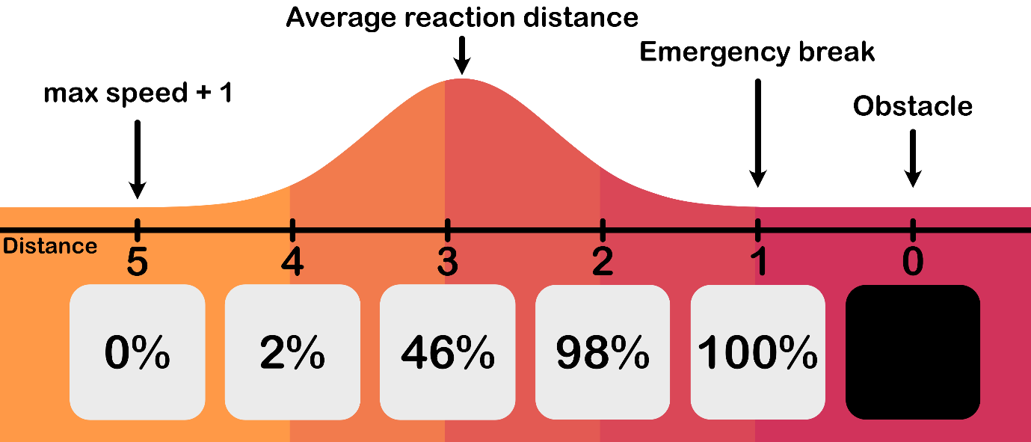


Cars
Types of obstacles:
Cars – Crossroads - Roundabouts

Slide 13
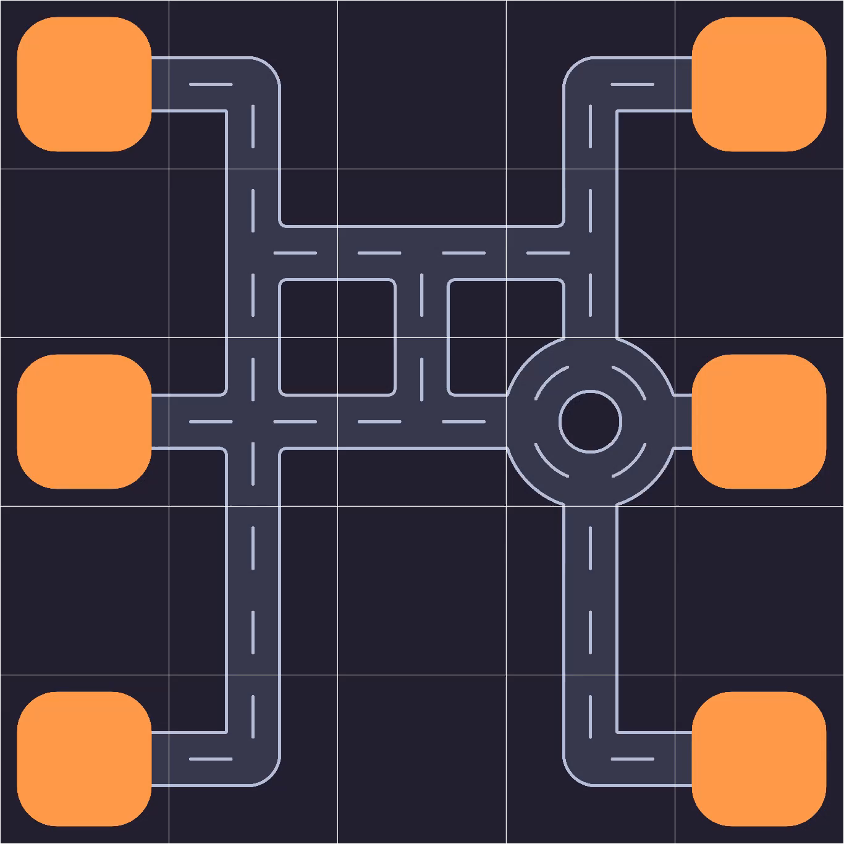
Path Finding
Velocity
Density graph
slow
fast
sparse
dense

Slide 14
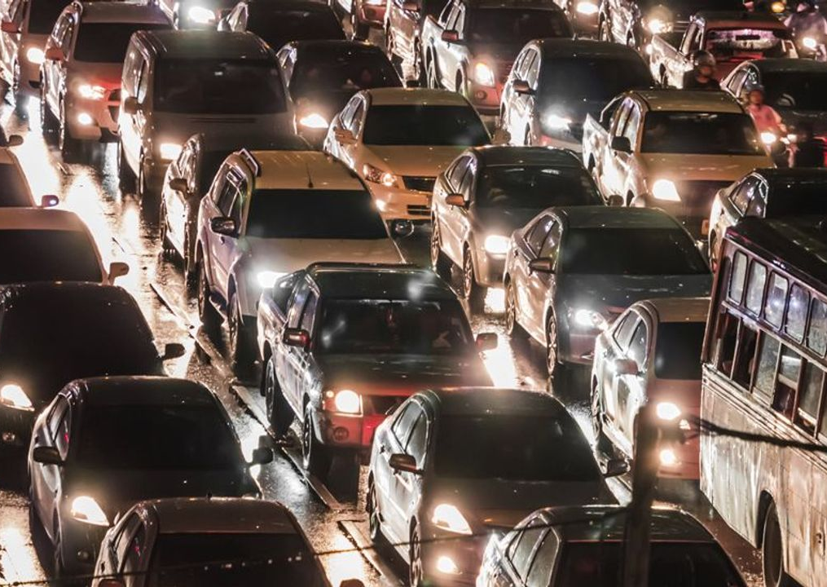
Three Phase Traffic Model
Proposed by B.S. Kerner
1996
Image by chat9780

Slide 15
Free Flow
Cars have minimal interactions
Moving at around maximum velocity
Occurs at low density

Slide 16
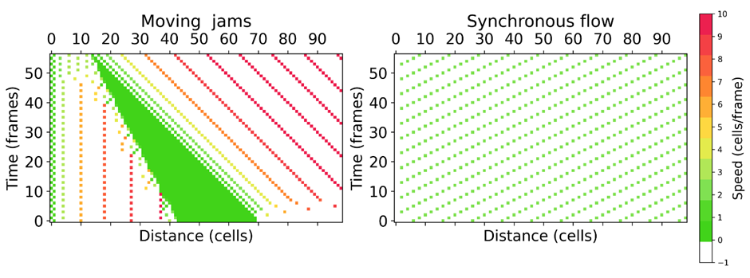
Synchronous Flow
Similar to free flow:
Coherent speeds
Flow rate/car flux
Where it differs:
Higher traffic density
Lower relative speed
Occurs spontaneously past the 'critical density'
Also occurs at bottlenecks and obstructions
Forms a 'platoon' of cars all at a similar velocity

Slide 17
Wide Moving Jam
Occurs past the critical density
Does not occur spontaneously from free flow
This finding helped B.S. Kerner to develop this theory

Slide 18

Simulation Results
Image by Micheal Bodmann

Slide 19
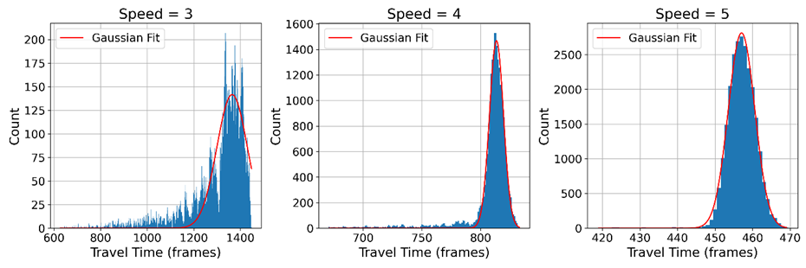
Straight Road: Varying Average Speed
We see three stages that are repeated throughout the data:
Coarse and wide
Transitional
Smooth Gaussian
With fixed departure time, varying speed results in varying density
As the speed increases the distribution:
Gets less coarse
Tends to a gaussian
Standard deviation decreases
Amplitude increases

Slide 20
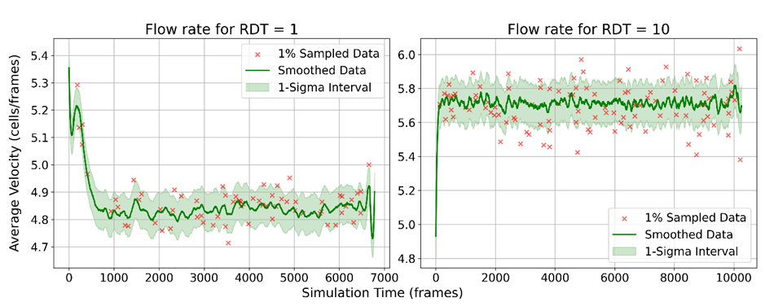
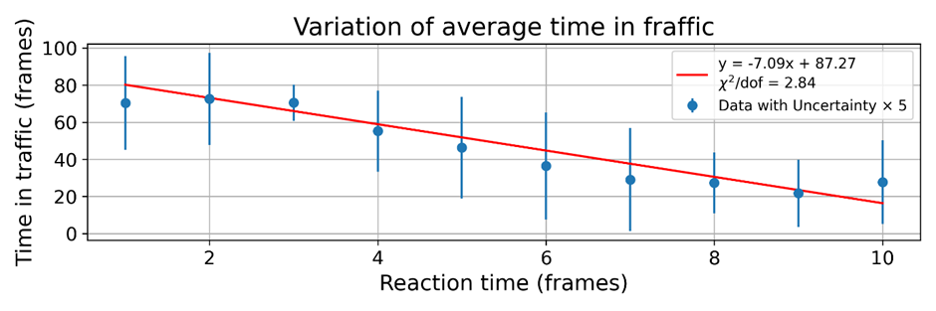
Straight Road: Varying Reaction Distance Threshold
Reaction distance threshold governs how soon a car reacts to an obstacle.
Increasing it smooths flow
Increases speed
Increases standard deviation

Slide 21
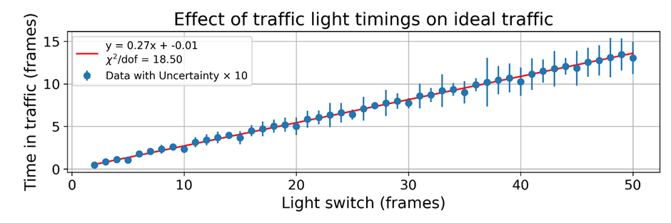
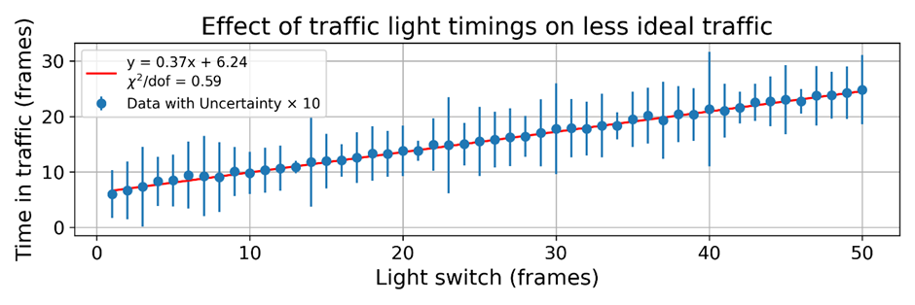
Four Way Junction: Efficiency of Traffic Light Times
In an idealised case:
Tight linear fit
Passes through origin
Predominant cause of traffic is the lights
In a less idealised case:
Wider spread between simulations
Does not pass through origin
Steeper gradient

Slide 22
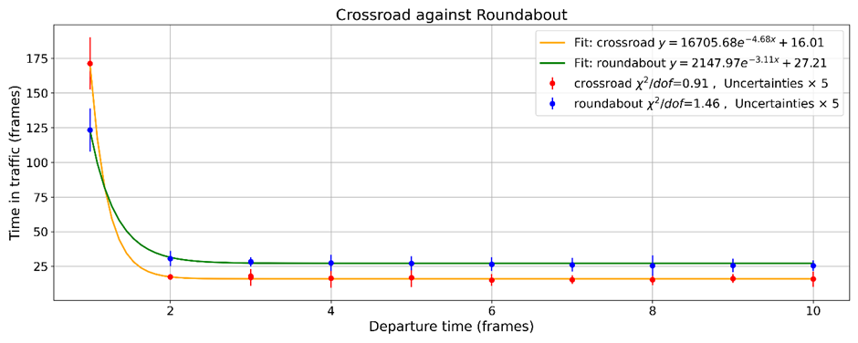
Four Way Junction: Comparing Traffic Lights and Roundabouts
Roundabouts cause less traffic at higher densities
Crossroads do better at lower densities

Slide 23
Evaluation and Recommendations
Behavior at junctions was inaccurate
Perfect vision round corners – traffic lights obselete
Roundbouts had no speed limit – high velocity simulations will be less accurate
Control of density
Would allow for more study of the flow-density relationship
Can find critical point to more accuracy
Continuous model
More realistic data
Possibly faster

